Slide 1

Calvert County Veterans Affairs Commission
Annual Report to the
Calvert County Board of County Commissioners
Dr. Brandon Temple, Chair
Patricia McCoy, Vice-Chair
Ed Sullivan, BOCC Representative
October 1, 2024

Slide 2
Purpose
To report to the Board of County Commissioners and the Citizens of Calvert County on the accomplishments of the Calvert County Veterans Affairs Commission in our third year.
2

Slide 3
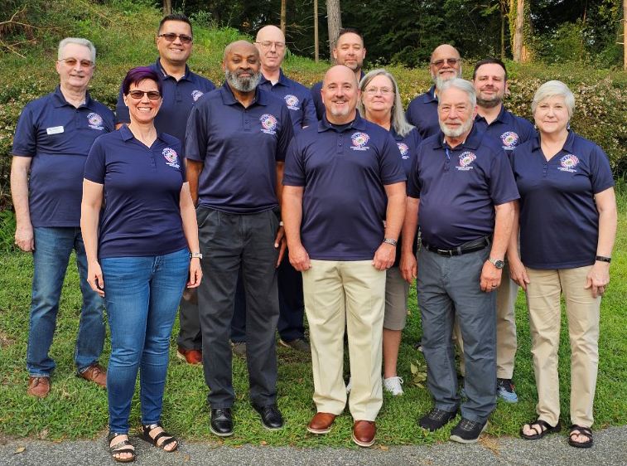
Calvert County Veterans Affairs Commission
Dr. Brandon Temple, Chair, Educator/Educational Admin Rep
Patricia McCoy, Vice-Chair, Am Legion Post 206
Sarah (Meg) Arthur, District 1
John Gray, American Legion Post 220
Jeffrey King, Business Owner Rep
Michael Richardson, American Legion Post 274
Robert Sprecher, American Legion Post 85
Michael Sweeney, District 2
Craig J. Jones, District 3
[NEED NEW PHOTO]
3

Slide 4
Calvert County Veterans Affairs Commission
Ex-Officio Members
Ed Sullivan, Division Chief, Calvert County Office on Aging, BOCC Rep
Christian Zimmermann, Associate Dean, College of So. MD
Kristin Byerly, Director, Veterans Initiatives, University of Maryland Global Campus
4

Slide 5
Organizational Purpose
Honor, advocacy and respect for Calvert County Veterans.
Vision
“All Calvert County veterans are receiving the benefits and services to which they are entitled.”
Mission Statement
“To advocate for all Calvert County veterans and their families while fostering a spirit of fellowship for veterans in our community.”
5

Slide 6

State Level Happenings
The Maryland Department of Veterans Affairs is now the Maryland Department of Veterans and Military Families.
New name reflects the department's mission to serve a diverse community, including dependents, caregivers, and survivors.
Change follows legislation (SB0411 and HB0431), signed by Governor Moore on April 9, 2024.
Dana Burl appointed Deputy Secretary of Military Family Policy and Programs.
6

Slide 7
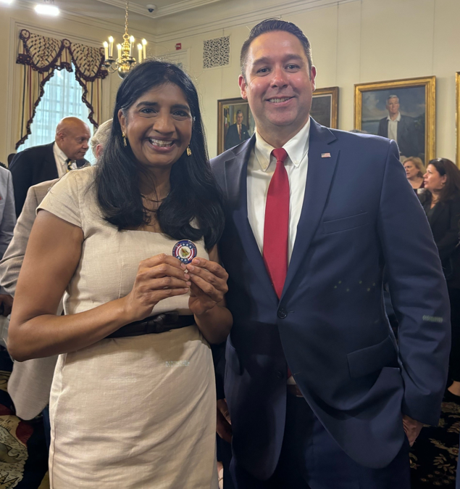
State Level Happenings
Maryland named a "Hidden Heroes" state.
Part of the Elizabeth Dole Foundation’s Hidden Heroes campaign, a nationwide effort to support those caring for ill or wounded service members.
Strengthens commitment to caregiver support through state/community programs.
7

Slide 8
State Regional Participation
CBOC Governance Council
Maryland Joint Veterans Commissions
Veterans Regional Advisory Commission
VSS (Veteran Services Specialist) Program
8
Notes:
Veterans Court Initiative - Per SA Harvey, by the end of September, Maryland courts use a question on the intake form to begin screening candidates for mental health and drug court dockets to determine if they, or a member of their immediate family, has ever served in the military.
When a veteran is accepted into either program, he or she will be referred to MD Commitment to Veterans, for referral to available resources. The State’s Attorney’s office will track of the number of veterans who receive services. This is an example of a local effort that ended up having a state-wide impact.

Slide 9
Community Connections
Informational presentations by:
Adrian Gamboa, American Legion, Department Service Officer
Maryland Senator Michael Jackson, Veterans Caucus Chair
Xavier Teasley, Asst. Director of DC Area CBOCs
Secretary Anthony Woods, Secretary Veterans Affairs
Donny Williams, Regional Manager, ServingTogether
Theresa Reer, Military Support, Operation Second Chance
9

Slide 10
Community Connections
Informational presentations by:
Jim Buckingham, Director, Warfighter Advance
Tenika Wilson, Southern Regional Resource Coordinator, Maryland’s Commitment to Veterans
Dr. Anthony Nations, Leader PACT Act Initiative
Hannah Rodriguez, Maryland’s Commitment to Veterans
Dave McDowell, Director CCG Dept. of Public Safety
10

Slide 11
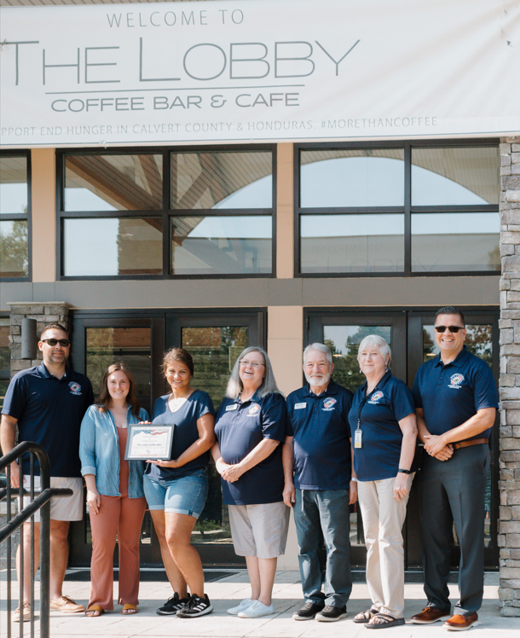
Certificates of appreciation
Communication and Media Relations
Faith & Freedom Quilts of Valor
Office on Aging
The Lobby Coffee Bar
Wear Your Spirit Warehouse
11

Slide 12
Veterans Feedback
Most frequently identified needs remain:
Access to information on VA benefits and services
Caregiver Support/Resources
Mental health/medical care/suicide prevention
Transportation to VA medical facilities
12

Slide 13
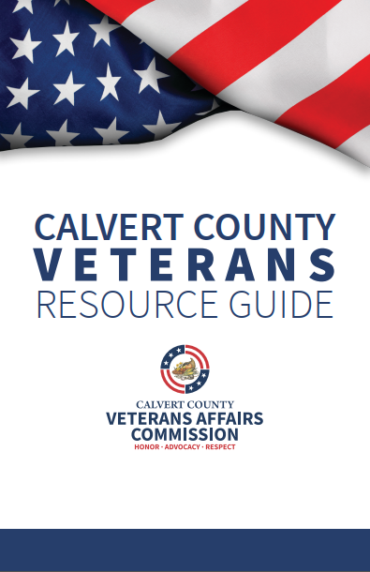
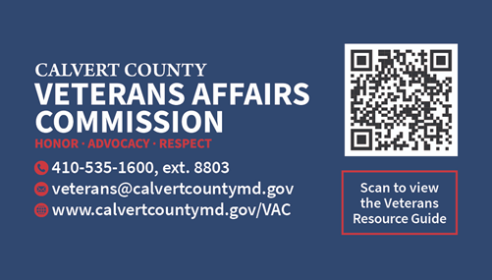
Veterans Resource Guide
Regularly updated “Living” document
Social media promotional campaign
Promotional business cards
QR Code
13

Slide 14
Veterans Events
2024 Community Resource Day
2023 & 2024 Calvert County Fair
2024 Memorial Day Ceremonies
2024 Women’s & Men’s Health Expos, Calvert Health
2023 & 2024 Operation Green Light/Veterans Day
2023 & 2024 National Veteran-Owned Business Week
14

Slide 15
Social Media
Strong coordinated social media presence
Evergreen posts for military milestones
Newsletter-12 editions-252 subscribers
Continued collaboration with Economic Development and Communications and Media Relations
Now also posting on Community Resources and Office on Aging FB pages
15

Slide 16
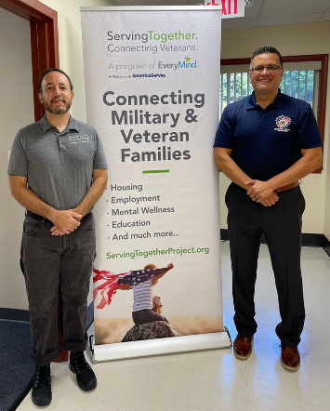
Accomplishments
CCVAC/Serving Together partnership to provide in-person veteran support and resources at Southern Pines Senior Center.
First day of service, Wed. Aug. 14th.
19 Veterans Served to date.
Potential to add additional days/locations.
16
Notes:
Veterans Court Initiative - Per SA Harvey, by the end of September, Maryland courts use a question on the intake form to begin screening candidates for mental health and drug court dockets to determine if they, or a member of their immediate family, has ever served in the military.
When a veteran is accepted into either program, he or she will be referred to MD Commitment to Veterans, for referral to available resources. The State’s Attorney’s office will track of the number of veterans who receive services. This is an example of a local effort that ended up having a state-wide impact.

Slide 17
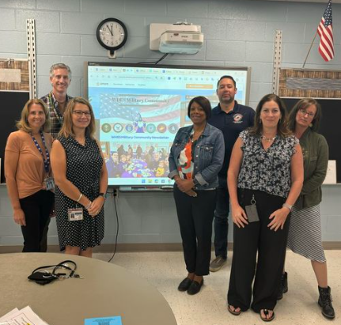
Accomplishments
Purple Star Schools Program
Expanded community outreach
eNews Blast
Increased social media presence, and participation in community events
Participating in Calvert Health Mental Health Implementation Plan activities
17
Notes:
Veterans Court Initiative - Per SA Harvey, by the end of September, Maryland courts use a question on the intake form to begin screening candidates for mental health and drug court dockets to determine if they, or a member of their immediate family, has ever served in the military.
When a veteran is accepted into either program, he or she will be referred to MD Commitment to Veterans, for referral to available resources. The State’s Attorney’s office will track of the number of veterans who receive services. This is an example of a local effort that ended up having a state-wide impact.

Slide 18
2024-2025 Goals
Continue promoting veteran/military related observances and implementing outreach strategies
Expand Purple Star Schools Program
Purple Heart County Designation
Hidden Heroes Caregiver Community Designation
Revisit Disabled Veterans Property Tax Credit in FY26
18

Slide 19
QUESTIONS?
19

